Slide 1
Pic 10C Project Bruinopoly
Team members: Yuxin Qian, Daniel Becerra, Chuqi Bian, Hao Zheng

Slide 2
Bruinopoly
> It’s our UCLA version of the Monopoly Game
>The basic process is like a normal monopoly, but we added many special features to make it unique and complex.
>The game program is made up by a welcome window, a game setup page and a main window for gameboard.

Slide 3
Class Hierarchy
>UI class:
GameBoard, PlayerInfoDisplay, QLandingWindow, Movement
>Other class:
Mainwindow, Bank, Board, Dice,

Slide 4
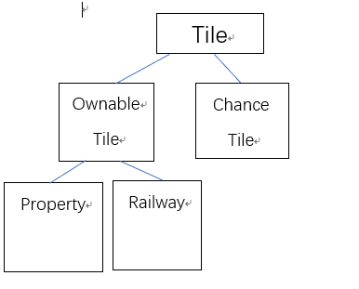
Tile Class Hierarchy

Slide 5
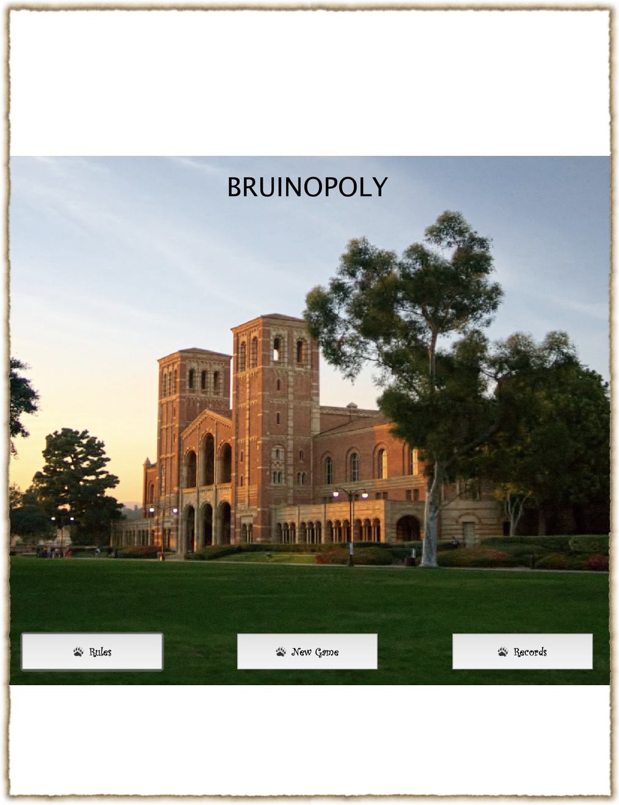
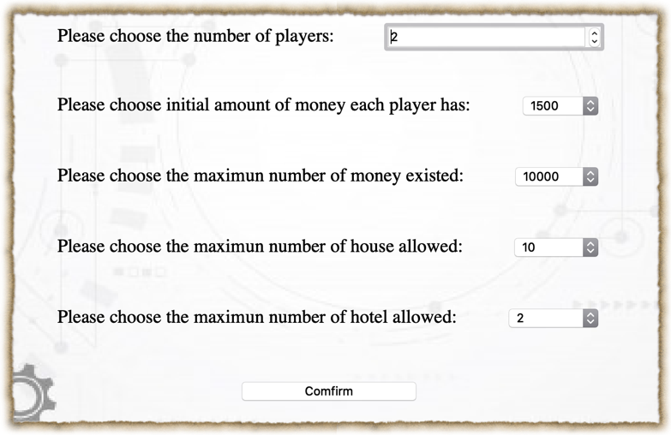
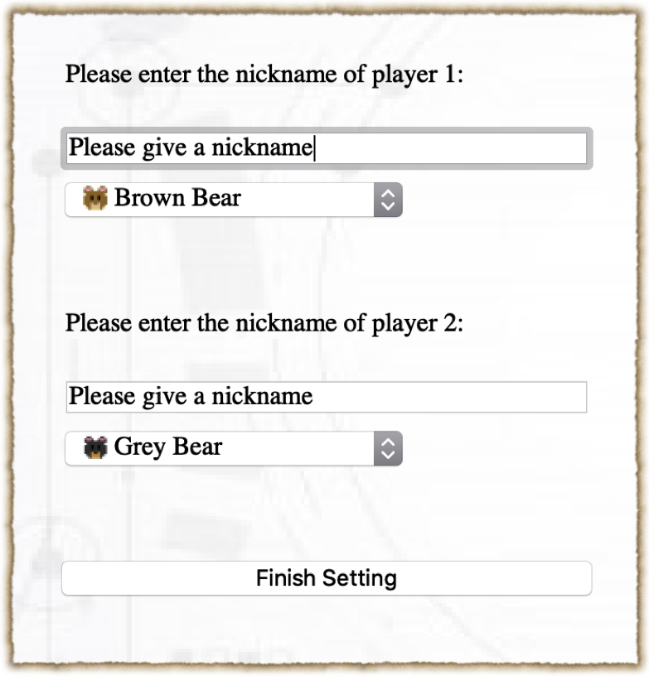
You can choose up to 4 players.
Also, you can decide the initial money and game setup!
Besides NewGame, there is also a Record page that can show the past game record.
Players can choose from different bear characters

Slide 6
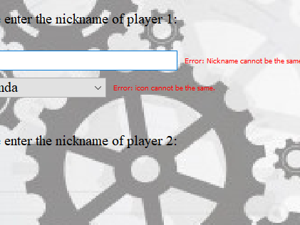

Here checks the player icon and nickname. Icon cannot be the same and nickname cannot be empty nor the same

Slide 7
Since some random events may not be shown in the presentation, we would firstly use some screenshots to exhibit those special events.

Slide 8
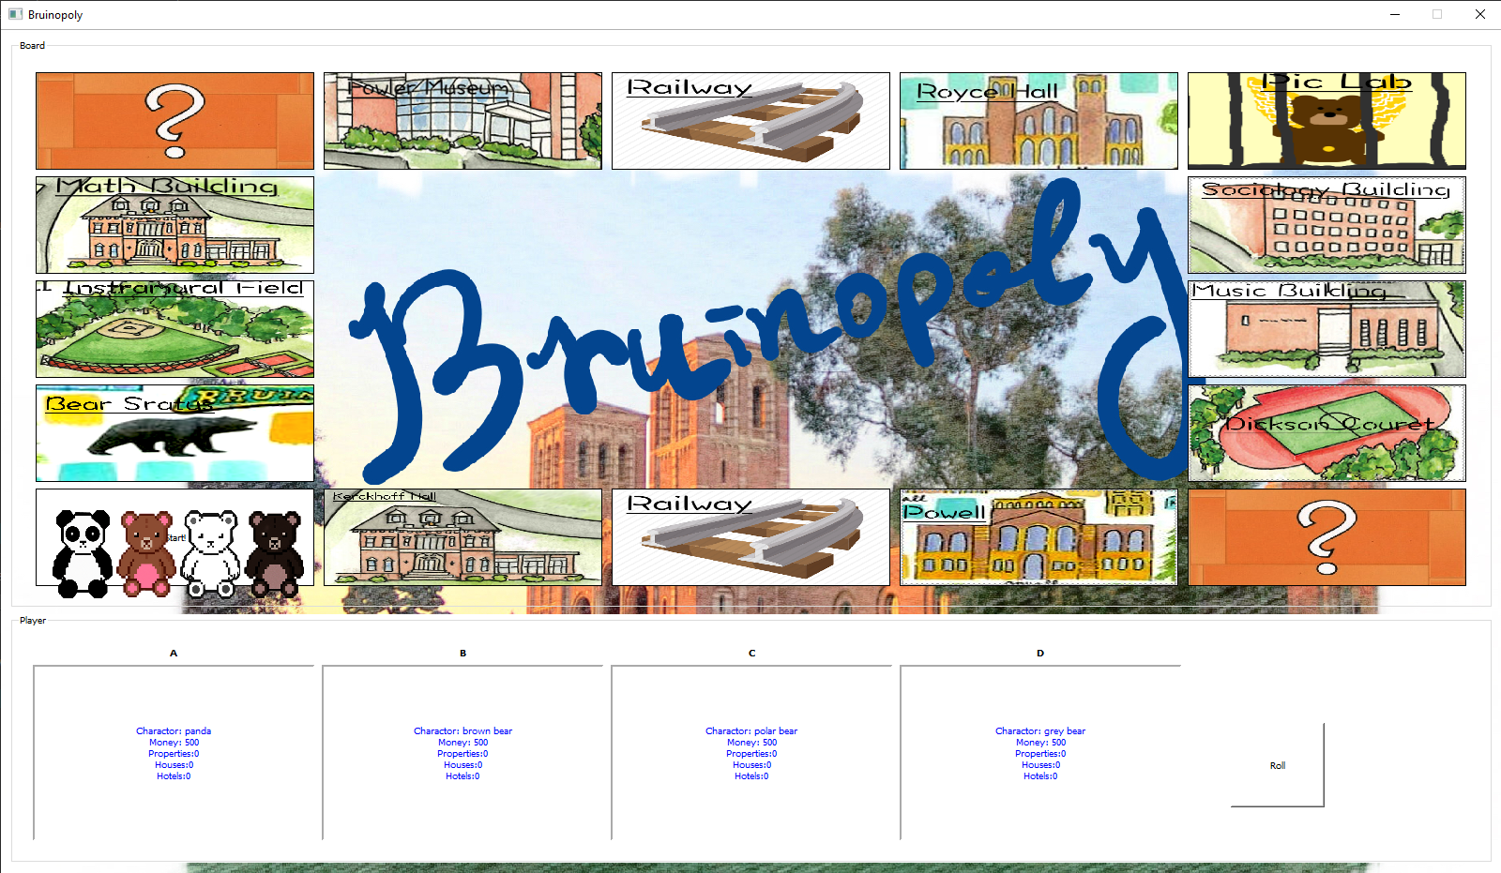

The gameboard contains 13 buyable properties. Different properties have different prices and rents. When landing on the property, certain property with information would show up

Slide 9
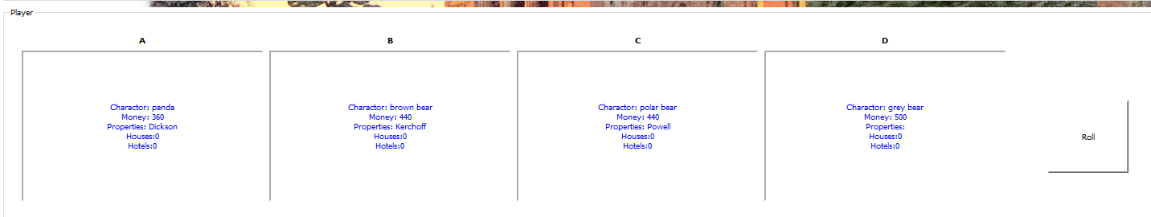
The player display area will display the player’s up to date gaming status.

Slide 10
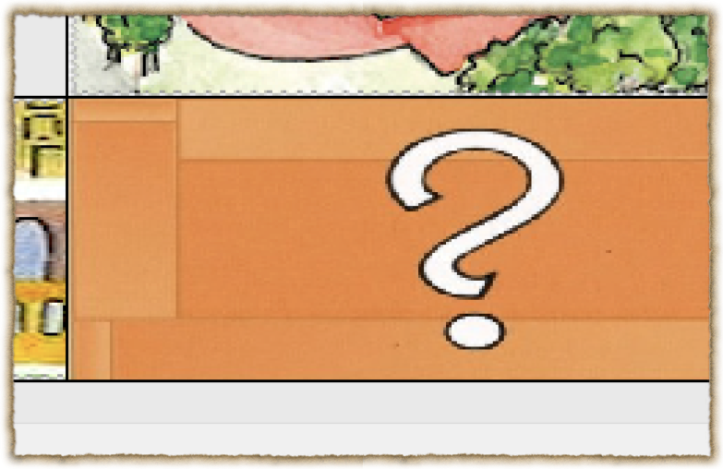

when Landing on the Chance
cards, a card generated by
QRand would show up.
Likely events includes gaining
money, losing money,
stopping for one turn or
going to the pic lab (jail.)

Slide 11
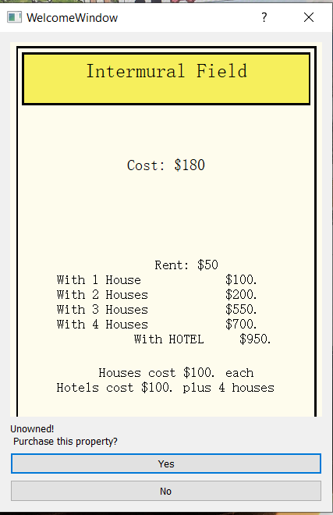
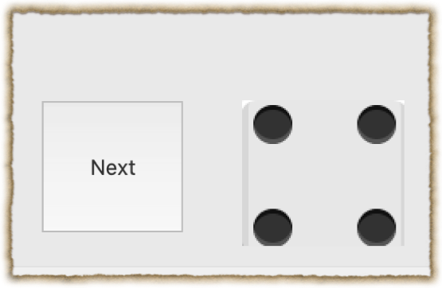
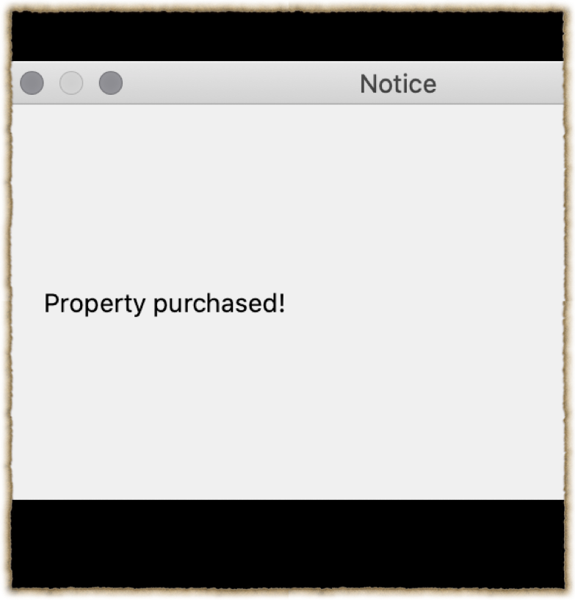
The dice would generate
random steps.
When landing on a property, the program will check whether it is
owned. You can buy owned property. Otherwise, you will need
to pay a rent

Slide 12
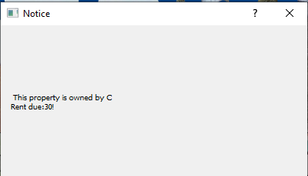
If, by accident, land on some one else’s tile,
then it would trigger this notice

Slide 13
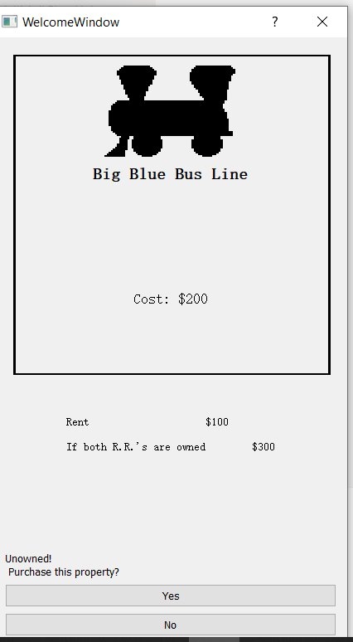
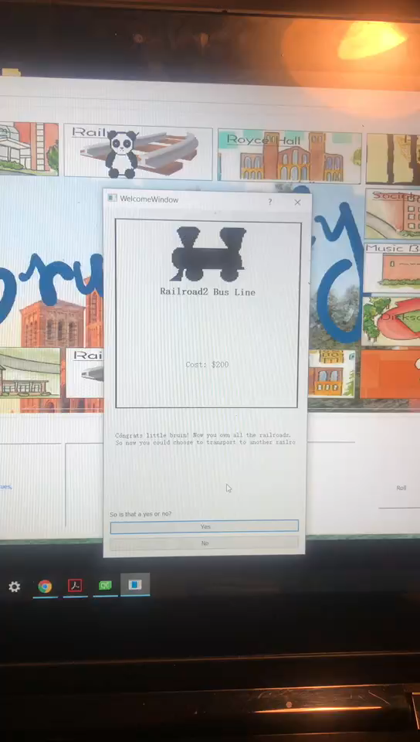
Players are not allowed to build houses
on bus line, instead, if they own more than
Two railroads, they can transport to the
Other.

Slide 14
>Players can add houses and hotels to their properties.
In this case, other players landing on it would be forced to pay a higher rent.
> When all the other players bankrupt, the
remaining one would be the winner.
>The game record would show up on the record
page.

